Slide 1
Symmetric Encryption
Lesson Introduction
Block cipher primitives
DES
AES
Encrypting large message
Message integrity
Notes:
Headshot

Slide 2
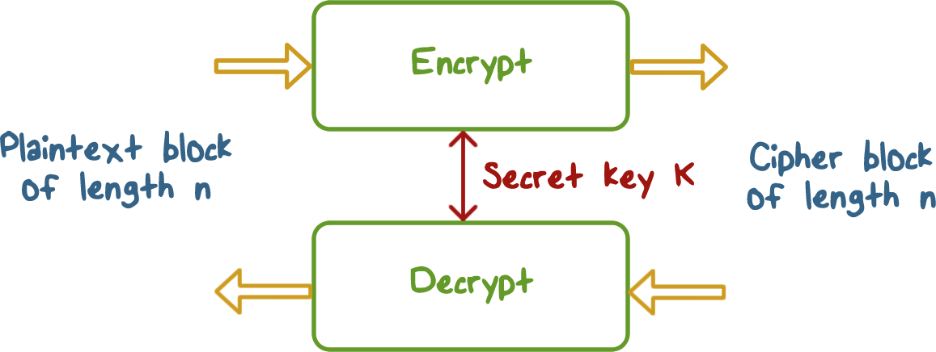
Block Cipher Scheme
Notes:
Most symmetric encryption schemes are called block ciphers because they take a fixed-length plaintext block as input. We will discuss later how these schemes can be used to encrypt input text of arbitrary length.
A fixed-length of plaintext block, say, in n-bit, is encrypted with a secret key k to produce a ciphertext of the same length n. The same key is used to decrypt the ciphertext to plaintext.

Slide 3

Block Cipher Primitives
Confusion:
An encryption operation where the relationship between the key and ciphertext is obscured
Achieved with substitution
Notes:
The goal of encryption is to transform a plaintext into an unintelligible form.
We always assume that the attacker can see the ciphertext, for example, because it is transmitted on the network and the attacker can capture the packet.
But we don’t want the attacker to be able to learn about the plaintext given the ciphertext.
In order to accomplish this, we apply two principles.
Confusion – think about the generalized substitution ciphers where each letter can be mapped to any other.

Slide 4
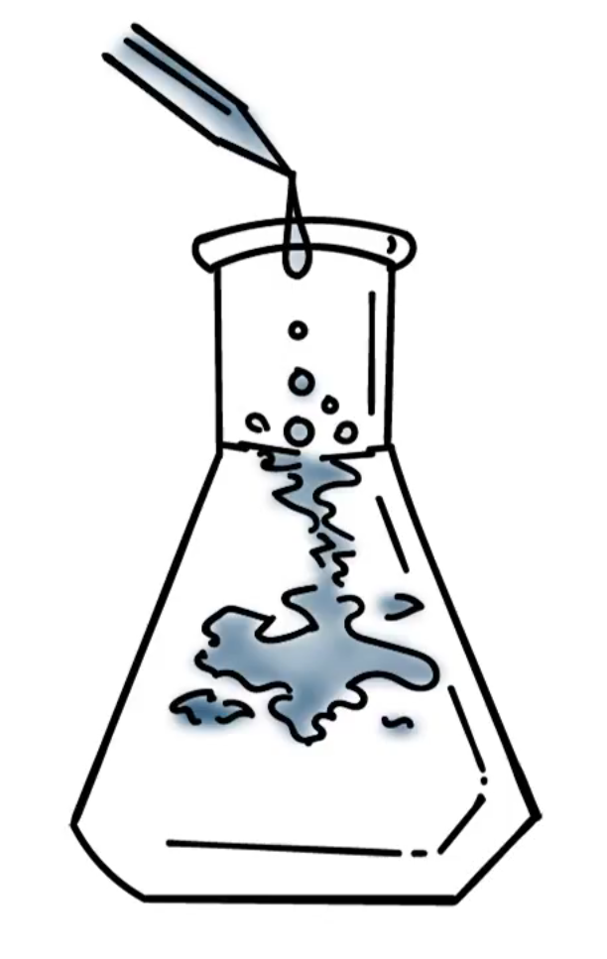
Block Cipher Primitives
Diffusion:
An encryption operation where the influence of one plaintext bit is spread over many ciphertext bits with the goal of hiding statistical properties of the plaintext
Achieved with permutation
Notes:
But that is not enough, e.g., statistical analysis of letters, so we also need diffusion, e.g., a letter is not just mapped to another letter in the English alphabet, it is mapped to “parts” of many 8-bit letters. So applying statistical distribution of English letters won’t work.

Slide 5
Block Cipher Primitives
Both confusion and diffusion by themselves cannot provide (strong enough) security
Round: combination of substitution and permutation, and do so often enough so that a bit change can affect every output bit
Notes:
As we have just discussed, we need both confusion and diffusion.
Further, we need this combination to affect every bit of the ciphertext. So, block cipher works in round, each round combines substitution and permutation. So the first round affect some parts of ciphertext, and the next round further propagates these effects into other parts of the ciphertext. Eventually, all bits of ciphertext are affected.

Slide 6

Block Cipher Quiz
Select all correct answers to complete that statement.
A block cipher should...
Use substitution to achieve confusion
Use permutation to achieve diffusion
Use a few rounds, each with a combination of substitution and permutation
Keep the algorithm secret
Notes:
Quiz:
Discuss
Solution:
Choose all

Slide 7
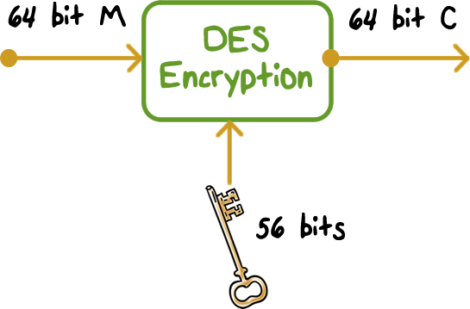
Data Encryption Standard
Published in 1977, standardized in 1979
Key: 64 bit quantity=8-bit parity+56-bit key
Every 8th bit is a parity bit
64 bit input, 64 bit output
Notes:
The most widely used encryption scheme is based on the Data Encryption Standard
(DES) adopted in 1977 by the National Bureau of Standards, now the National
Institute of Standards and Technology (NIST), as Federal Information Processing
Standard 46 (FIPS PUB 46).
The DES algorithm can be described as follows. The plaintext is 64 bits in
length and the key is 56 bits in length; longer plaintext amounts are processed in
64-bit blocks.

Slide 8
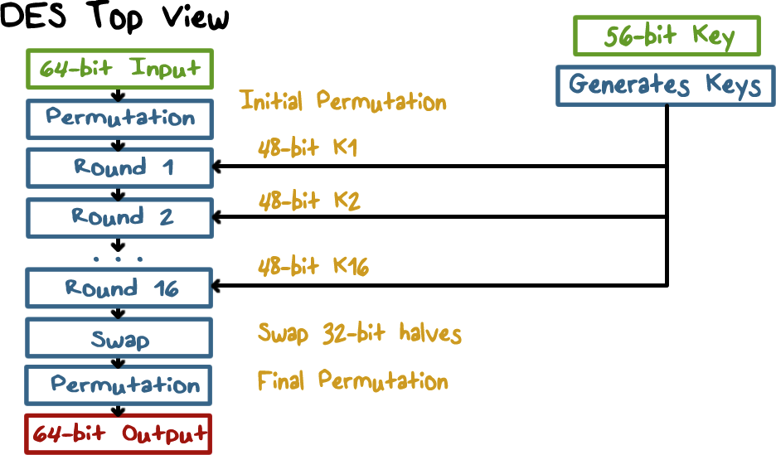
Data Encryption Standard
Notes:
There are 16 rounds of processing. From the original 56-bit key, 16
subkeys are generated, one of which is used for each round.
The process of decryption with DES is essentially the same as the encryption
process. The rule is as follows: Use the ciphertext as input to the DES
algorithm, but use the subkeys K _{i} in reverse order. That is, use K ₁₆ on the first
iteration, K ₁₅ on the second iteration, and so on until K 1 is used on the sixteenth
and last iteration.

Slide 9
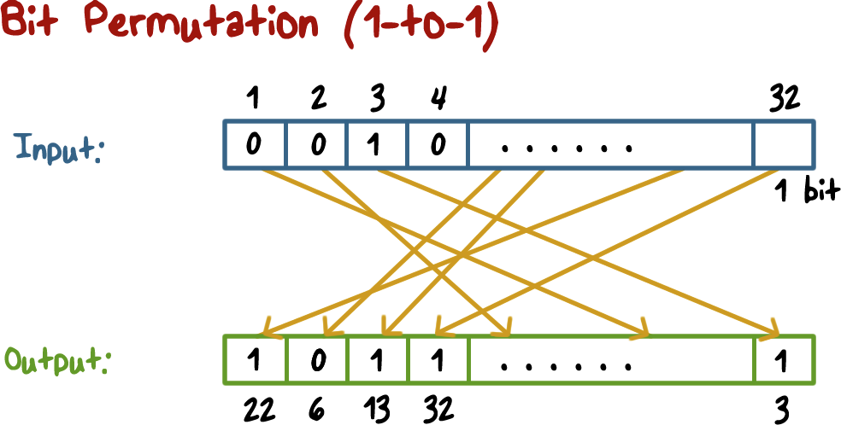
Data Encryption Standard
Notes:
This illustrates how permutation works: by changing the positions of bits

Slide 10
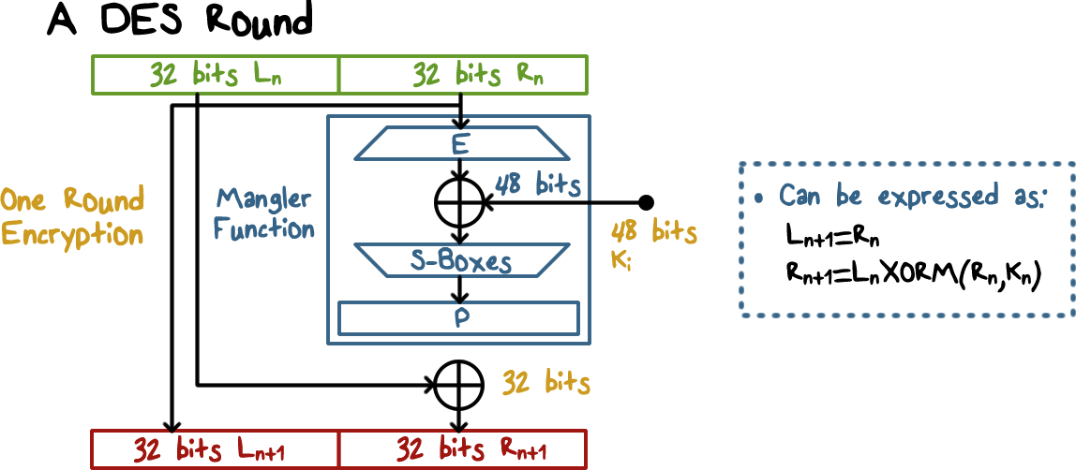
Data Encryption Standard
Notes:
Here is an illustration of the operations in a DES round.
Each takes as input the ciphertext thus far and the per round key and outputs ciphertext for the next round.
The input is divided into left and right halves.
The output left half is just the input right half.
The output right half is the result of XORing the input left half with the output of the Mangler process, which takes as input the input right half, expands it to 48 bit, and XORes it with the per-round key, and then uses S boxes to substitute the 48-bit data with another 32-bit data.
---
We can also simply use algebra to represent the processing in a DES round.

Slide 11

Decryption
Apply the same operations key sequence in reverse:
Round 1 of decryption uses key of the last round in encryption
Each round:
Input: R_{n+1}|L_{n+1}
Due to the swap operation at the end of encryption
Output: R_{n}|L_{n}
The swap operation at the end will produce the correct result: L|R
Notes:
DES structure is a Feistel network, that is, encryption and decryption differ only in key schedule.
In DES decryption, round 1 key is the round 15 encryption key, round 2 key is the round 14 encryption key, etc., and round 16 key is the round 1 encryption key.
At each round, the input is R_n+1 | L_n+1 because of the swap operation at the end of encryption rounds.
You can use the algebra formulas to verify that the output is R_n|L_n
Then then swap operation at the end of rounds outputs the correctly ordered plaintext.

Slide 12
XOR Quiz
Use the XOR function and the given key to encrypt the word “Hi”.
key = FA F2
Hi =
FA F2 =
Hi encrypted =
Notes:
Quiz:
The XOR function is often used for encryption. Let’s do a quiz as a quick refresher.
Use the XOR function to encrypt the word “Hi”, using the given key.
There is a link in the instructor notes you may find helpful.
Solution:
The first step is to convert the characters to their ascii codes.
H = 48, i = 69
Hi = 0100 1000 0110 1001
FA F2 = 1111 1001 1111 0010
Recall the XOR function truth table:
0 xor 0 = 0
0 xor 1 = 1
1 xor 0 = 1
1 xor 1 = 0
Hi encrypted = 1011 0001 1001 1011

Slide 13
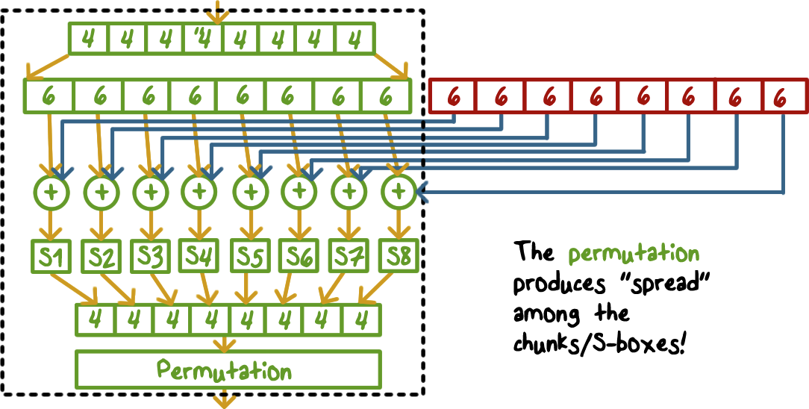
Mangler Function
Notes:
Here is an illustration of the mangler process.
Divide the 32bit input into 8 4 bit chunks. Each chuck is expanded to 6-bit, XOR with a 6-bit key chunk; and then 8 s-boxes each substituting a 6-bit chunk to a 4-bit chunk.

Slide 14
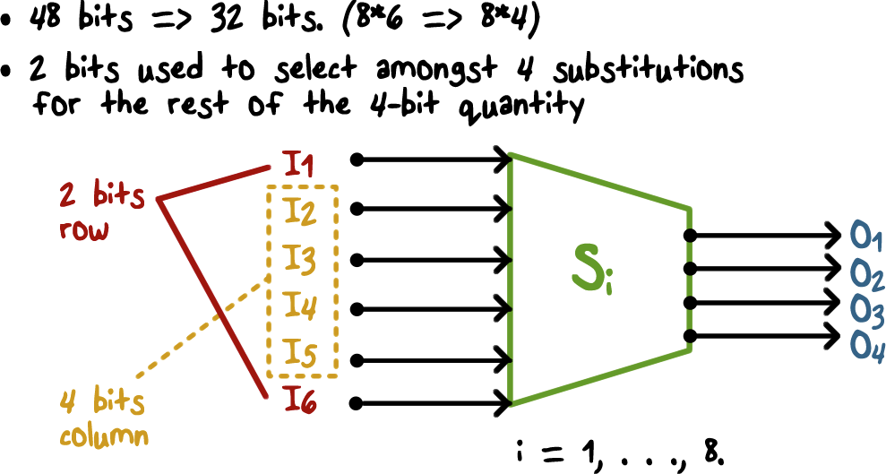
S-Box (Substitute and Shrink)
Notes:
A S-box substitutes a 6-bit value with a 4-bit value using a predefined table. The outer two bits index to the rows and the middle 4 bits index into the column and the value in the table entry is the output 4-bit value.

Slide 15
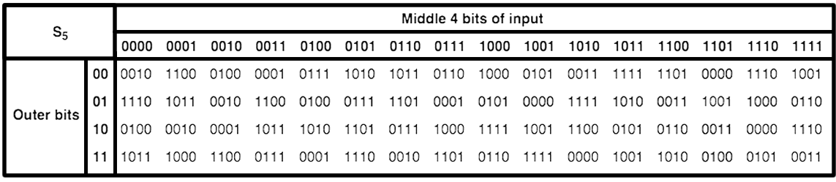
S-Box Quiz
For the given input, determine the output.
Output:
Input: 011011
Notes:
Quiz:
Now it’s your turn to try. For the given input, determine the output.
Solution:
The answer is 1001
The row is 01 (1)
The column is 1101 (13)

Slide 16

Security of DES
Key space is too small (2⁵⁶ keys)
Exhaustive key search relative easy with today’s computers
S-box design criteria have been kept secret
Highly resistant to cryptanalysis techniques published years after DES
Notes:
Discuss

Slide 17
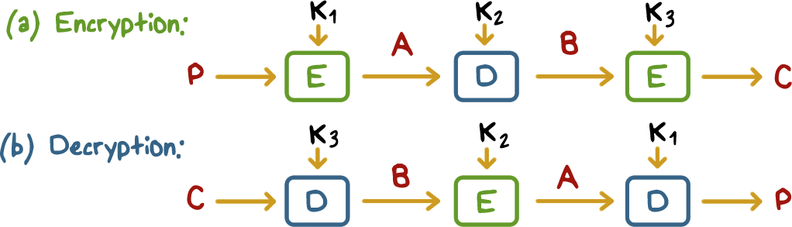
Triple DES
K₁=K₃ results in an equivalent 112-bit DES which provides a sufficient key space
Distinct K₁, K₂, K₃ results in an even stronger 168-bit DES
Can run as a single DES with K₁ = K₂
Notes:
In order to overcome the 56-bit key limit, we can run DES multiple times each using a different key. The standard is to run DES three times, and this is called Triple DES.

Slide 18
DES Quiz
Check all the statements that are true:
To decrypt using DES, same algorithm is used, but with per-round keys used in the reversed order
With Triple DES the effective key length can be 56, 112, and 168
Each round of DES contains both substitution and permutation operations
The logics behind the S-boxes are well-known and verified
Notes:
Quiz:
Discuss
Solution:
T
T
T
F

Slide 19
Advanced Encryption Standard
In 1997, the U.S. National Institute for Standards and Technology (NIST) put out a public call for a replacement to DES
It narrowed down the list of submissions to five finalists, and ultimately chose an algorithm (Rijndael) that is now known as the Advanced Encryption Standard (AES)
New (Nov. 2001) symmetric-key NIST standard, replacing DES
Processes data in 128 bit blocks
Key length can be 128, 192, or 256 bits
Notes:
The Advanced Encryption Standard (AES) was issued as a federal information processing
standard (FIPS 197). It is intended to replace DES and triple DES with an
algorithm that is more secure and efficient.

Slide 20
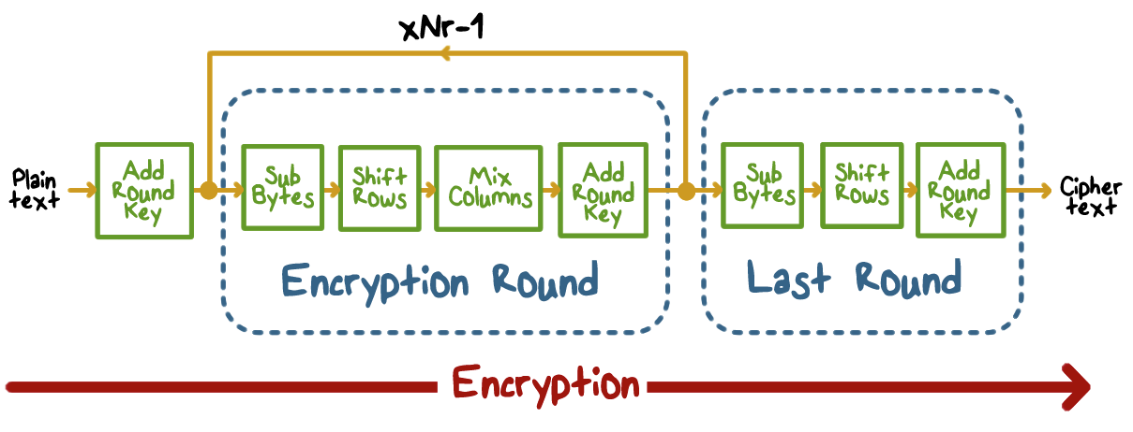
Advanced Encryption Standard
Notes:
Here is a high-level view of AES.
Layer1:
The input to the encryption
and decryption algorithms is a single 128-bit block. This block is
depicted as a square matrix of bytes. This block is copied into the State array, which
is modified at each stage of encryption or decryption. After the final stage, State is
copied to an output matrix. Similarly, the 128-bit key is depicted as a square matrix
of bytes.
-----
Layer 2:
1. One noteworthy feature of this structure is that it is not a Feistel structure.
Recall that in the classic Feistel structure, half of the data block is used to
modify the other half of the data block, and then the halves are swapped. AES
does not use a Feistel structure but processes the entire data block in parallel
during each round using substitutions and permutation.
2. The key is expanded into an array of forty-four 32-bit
words, w[i]. Four distinct words (128 bits) serve as a round key for each round.
3. Four different stages are used in each round, one of permutation and three of substitution:
• Substitute Bytes: Uses a table, referred to as an S-box, to perform a byte-by-
byte substitution of the block
-----
Layer 3:
• Shift Rows: A simple permutation that is performed row by row
-----
Layer 4:
• Mix Columns: A substitution that alters each byte in a column as a function
of all of the bytes in the column
-----
Layer 5:
• Add Round key: A simple bitwise XOR of the current block with a portion
of the expanded key
-----
Layer 6:
4. The structure of AES is quite simple. For both encryption and decryption, the cipher
begins with an Add Round Key stage, followed by nine rounds that each
includes all four stages, followed by a tenth round of three stages.
5. Only the Add Round Key stage makes use of the key. For this reason, the
cipher begins and ends with an Add Round Key stage. Any other stage,
applied at the beginning or end, is reversible without knowledge of the key
and so would add no security.
6. As with most block ciphers, the decryption algorithm makes use of the
expanded key in reverse order.
7. Encryption
and decryption going in opposite vertical directions.

Slide 21
AES Round
Notes:
This figure
depicts the structure of a full encryption round.
8. The Add Round Key stage by itself would not be formidable. The other three
stages together scramble the bits, but by themselves would provide no security
because they do not use the key. We can view the cipher as alternating operations
of XOR encryption (Add Round Key) of a block, followed by scrambling
of the block (the other three stages), followed by XOR encryption, and
so on. This scheme is both efficient and highly secure.
9. Each stage is easily reversible. For the Substitute Byte, Shift Row, and Mix
Columns stages, an inverse function is used in the decryption algorithm. For
the Add Round Key stage, the inverse is achieved by XORing the same round
key to the block, using the result that A ⊕ A ⊕ B = B.
10. As with most block ciphers, the decryption algorithm makes use of the
expanded key in reverse order.
11. Once it is established that all four stages are reversible, it is easy to verify
that decryption does recover the plaintext. Encryption
and decryption going in opposite vertical directions.

Slide 22
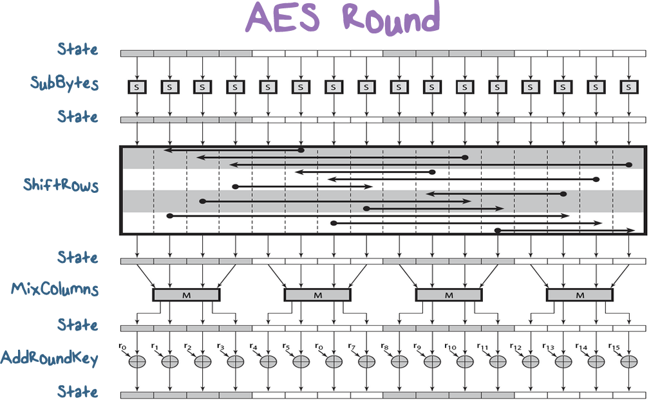
Notes:
This figure
depicts the structure of a full encryption round.
8. The Add Round Key stage by itself would not be formidable. The other three
stages together scramble the bits, but by themselves would provide no security
because they do not use the key. We can view the cipher as alternating operations
of XOR encryption (Add Round Key) of a block, followed by scrambling
of the block (the other three stages), followed by XOR encryption, and
so on. This scheme is both efficient and highly secure.
9. Each stage is easily reversible. For the Substitute Byte, Shift Row, and Mix
Columns stages, an inverse function is used in the decryption algorithm. For
the Add Round Key stage, the inverse is achieved by XORing the same round
key to the block, using the result that A ⊕ A ⊕ B = B.
10. As with most block ciphers, the decryption algorithm makes use of the
expanded key in reverse order.
11. Once it is established that all four stages are reversible, it is easy to verify
that decryption does recover the plaintext. Encryption
and decryption going in opposite vertical directions.

Slide 23
A Stick Figure Guide to AES
http://www.moserware.com/2009/09/stick-figure-guide-to-advanced.html

Slide 24
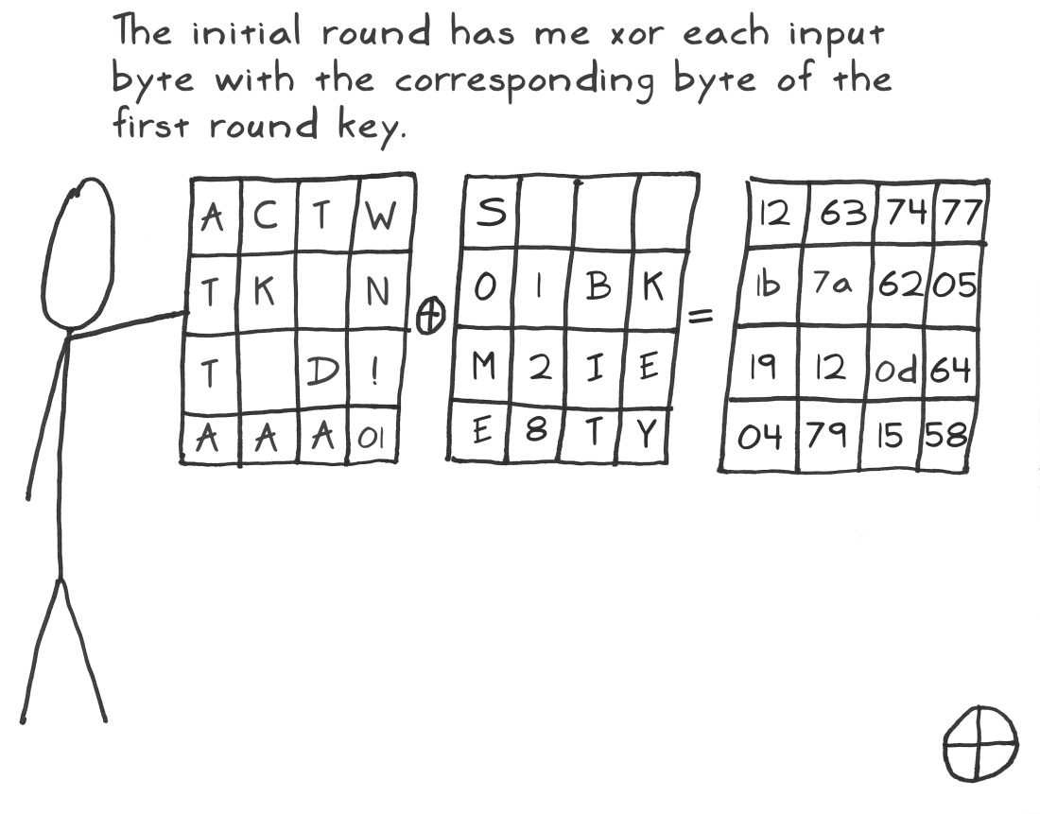
Notes:
Here is a sticky figure of AES round

Slide 25
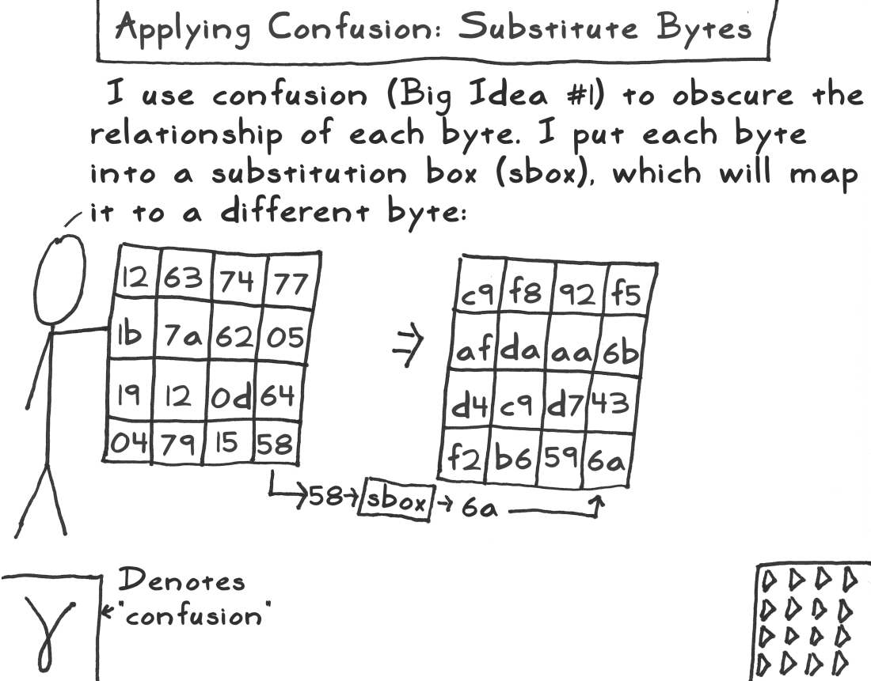

Slide 26
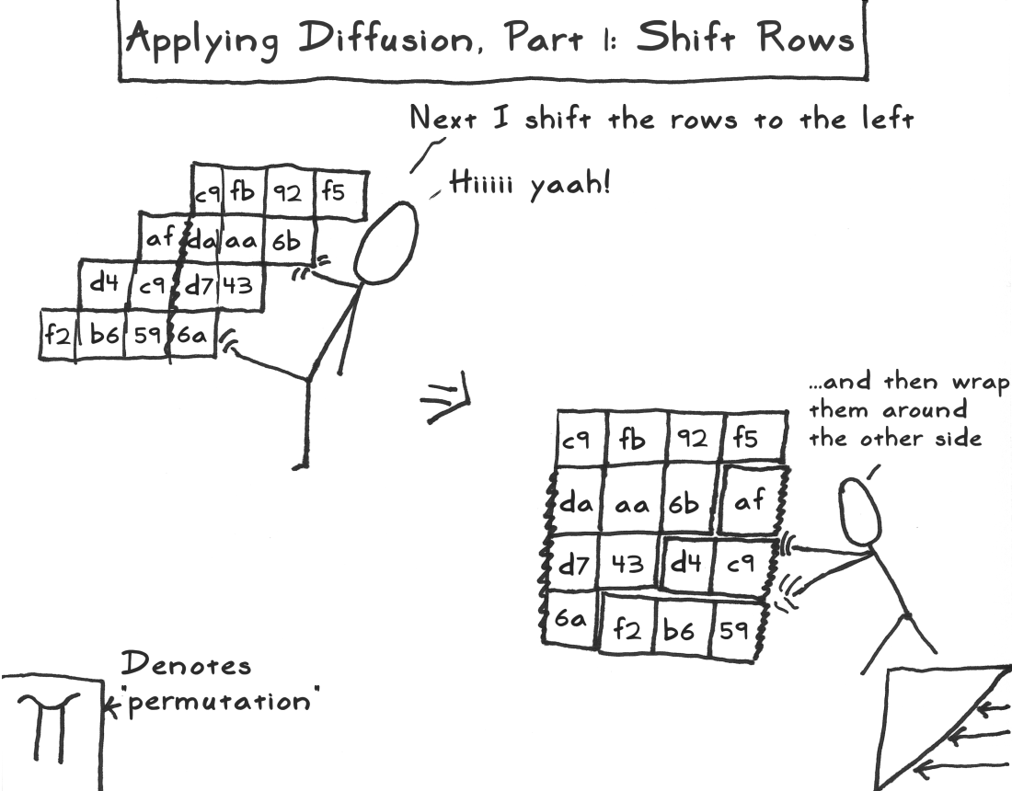

Slide 27
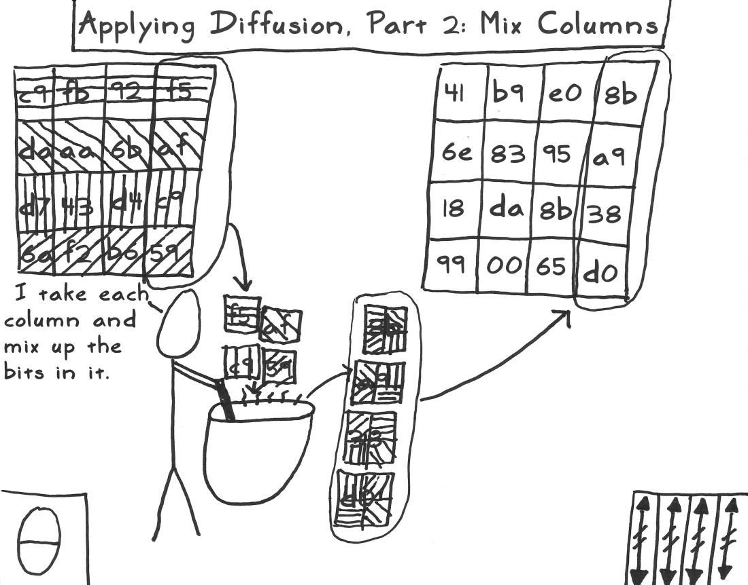

Slide 28
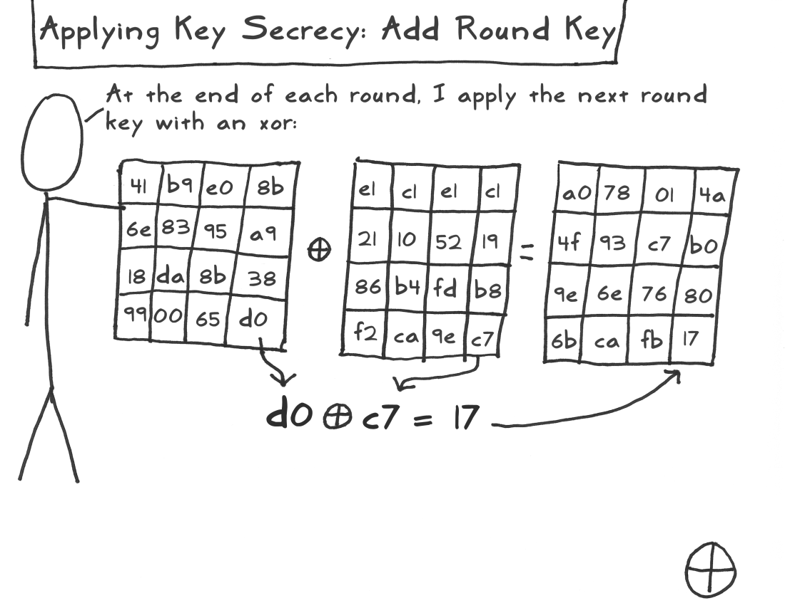

Slide 29
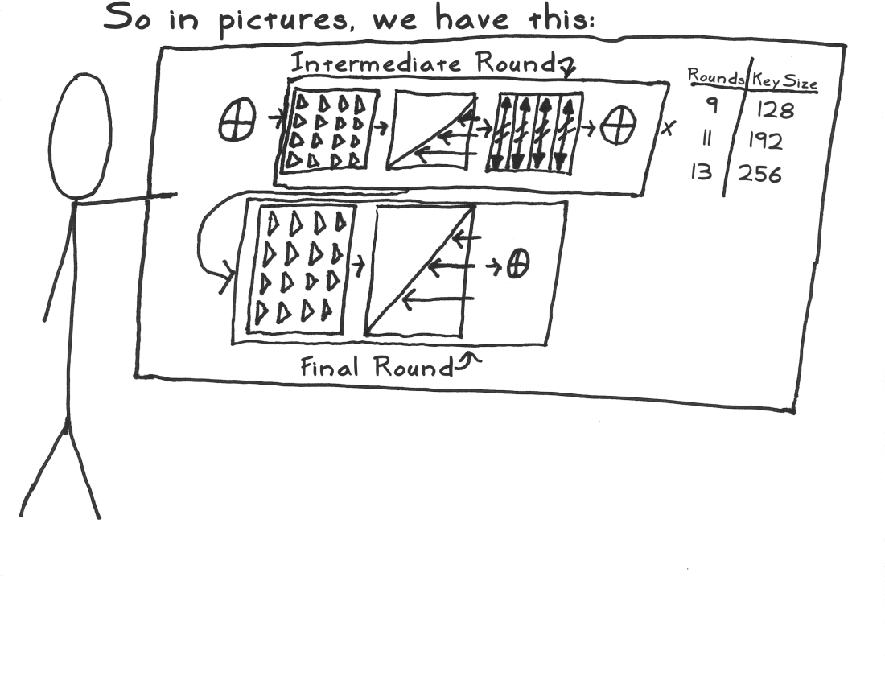

Slide 30
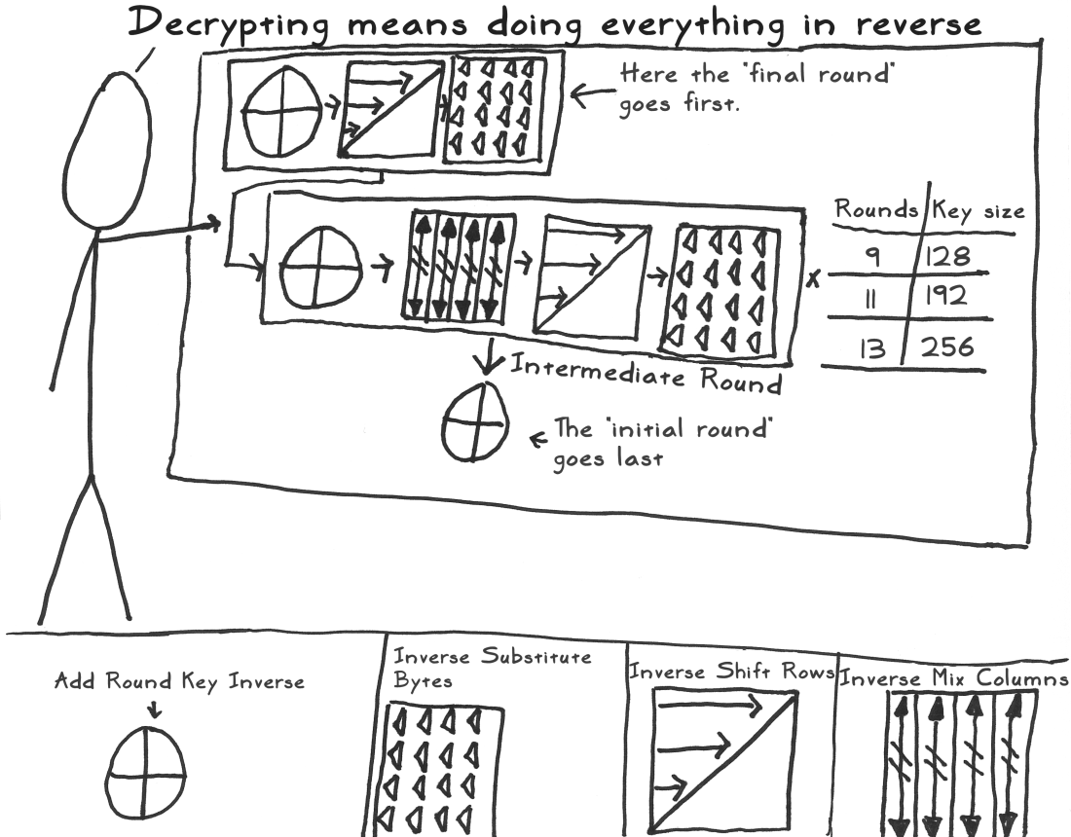

Slide 31
AES Encryption Quiz
Check all the statements that are true:
To decrypt using AES, just run the same algorithm in the same order of operations
Each operation or stage in AES is reversible
AES can support key length of 128, 192, 256
AES is much more efficient than Triple DES
Notes:
Quiz:
Discuss
Solution:
F
T
T
T

Slide 32

Encrypting a Large Message
Break a message into blocks
Apply block cipher on the blocks
Is that it?
Notes:
So far we have discussed block ciphers, which take as input a fixed-length data block, say in 64-bit for DES or 128-bit for AES What if we want encrypt a larger message?
We can first break the message into blocks, then encrypt each block using a block cipher. Is that it?

Slide 33
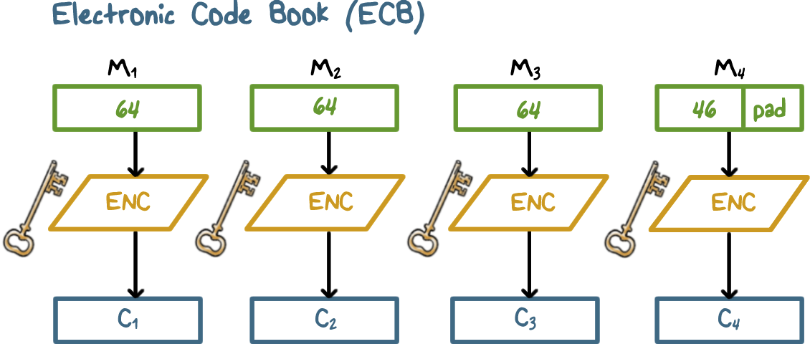
Encrypting a Large Message
Notes:
The simplest way to encrypt a large message is what is known as electronic codebook (ECB) mode,
in which plaintext is handled b bits at a time and each block of plaintext is encrypted
using the same key.
The term codebook is used because, for a given
key, there is a unique ciphertext for every b -bit block of plaintext. Therefore, one
can imagine a gigantic codebook in which there is an entry for every possible b -bit
plaintext pattern showing its corresponding ciphertext.

Slide 34
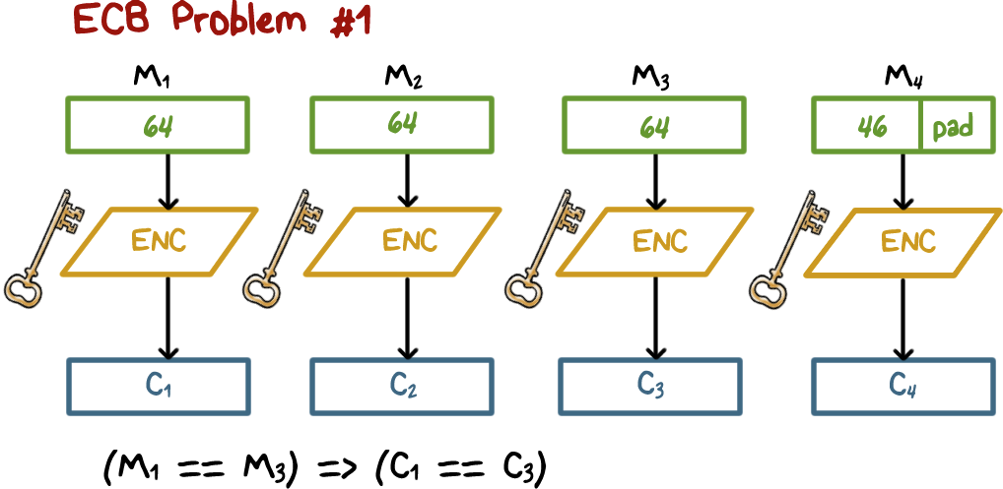
Encrypting a Large Message
Notes:
With ECB, if the same b -bit block of plaintext appears more than once in
the message, it always produces the same ciphertext. Because of this, for lengthy
messages, the ECB mode may not be secure. If the message is highly structured,
it may be possible for a cryptanalyst to exploit these regularities. For example, if
it is known that the message always starts out with certain predefined fields, then
the cryptanalyst may have a number of known plaintext-ciphertext pairs to work
with. If the message has repetitive elements, with a period of repetition a multiple
of b bits, then these elements can be identified by the analyst. This may help in the
analysis or may provide an opportunity for substituting or rearranging blocks.

Slide 35
Encrypting a Large Message
ECB Problem #2
Lack the basic protection against integrity attacks on the ciphertext at message level (i.e., multiple cipher blocks)
Without additional integrity protection
cipher block substitution and rearrangement attacks
fabrication of specific information
Notes:
An attacker can use a previously captured ciphertext block to swap out a current cipher text block, or rearrange the order of the cipher text blocks. The result is violation of message integrity, e.g., fabrication of information.

Slide 36
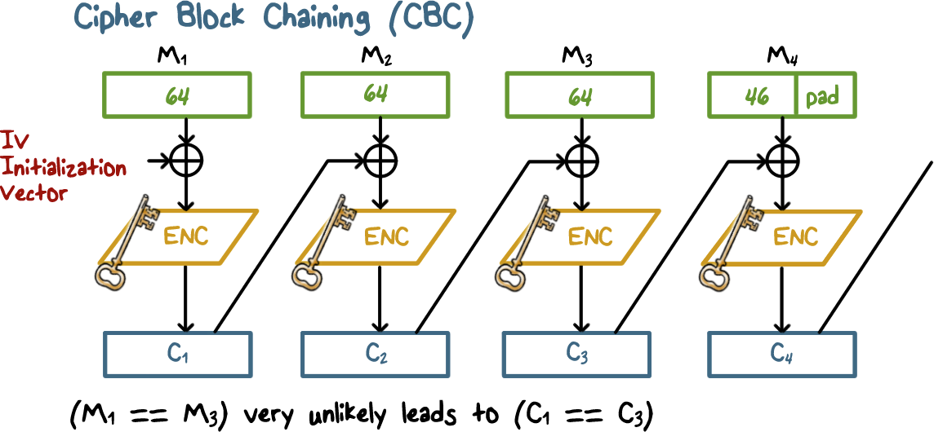
Encrypting a Large Message
Notes:
In the cipher block chaining (CBC) mode, the input to the encryption algorithm is the XOR of the current plaintext block and the preceding ciphertext block; the same key is used for each block. For the first block, we use a random value, which we call the Initiation Vector or IV. In effect, we have chained together the processing of the sequence of plaintext blocks. The input to the encryption function for each plaintext block bears includes the previous ciphertext block, not just the current plaintext block. So there is no way to determine the result of a single plaintext block in its own isolation. Therefore, if two plaintext blocks repeat in the same message or in two different messages, their ciphertext blocks are different from each other.

Slide 37
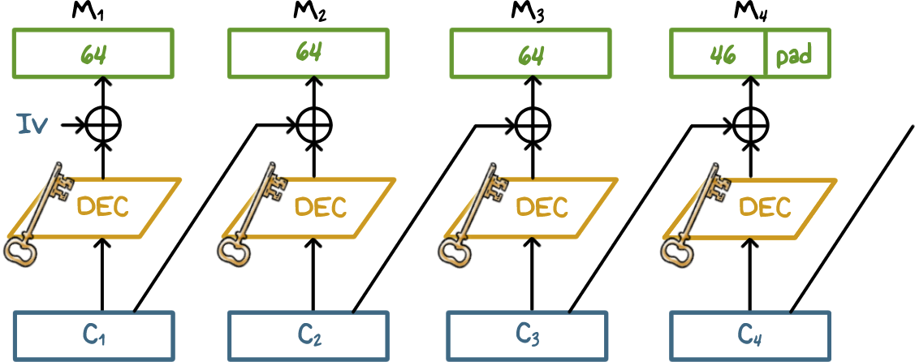
CBC Decryption
Notes:
For decryption, each cipher block is passed through the decryption algorithm. The result is XORed with the preceding ciphertext block to produce the plaintext block. To see that this works, we can write:
C_{j} = E(K, [C_{j–1} ⊕ P_{j}])
where E[K, X] is the encryption of plaintext X using key K, and ⊕ is the exclusive-OR operation.
To produce the first block of ciphertext, an initialization vector (IV) is XORed with the first block of plaintext. On decryption, the IV is XORed with the output of the decryption algorithm to recover the first block of plaintext.
The IV must be known to both the sender and receiver. For maximum security, the IV should be protected as well as the key. This could be done by sending the IV using ECB encryption. One reason for protecting the IV is as follows: If an attacker is able to fool the receiver into using a different value for IV, then the attacker is able to invert selected bits in the first block of plaintext, and violate message integrity

Slide 38
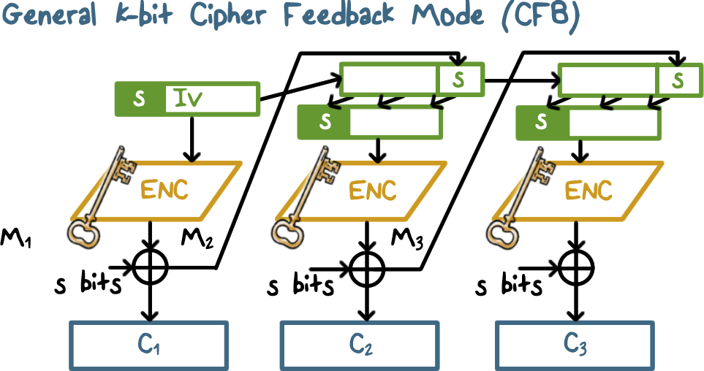
General K-Bit Cipher Feedback Mode (CFB)
Notes:
It is possible to convert any block cipher into a stream cipher by using the cipher feedback (CFB) mode. A stream cipher eliminates the need to pad a message to be an integral number of blocks. It also can operate in real time. Thus, if a character stream is being transmitted, each character can be encrypted and transmitted immediately using a character-oriented stream cipher.
One desirable property of a stream cipher is that the ciphertext be of the same length as the plaintext. Thus, if 8-bit characters are being transmitted, each character should be encrypted using 8 bits. If more than 8 bits are used, transmission capacity is wasted.
This figure the CFB scheme. In the figure, it is assumed that the unit of transmission is s bits; a common value is s = 8. As with CBC, the units of plaintext are chained together so that the ciphertext of any plaintext unit is a function of
all the preceding plaintext.
First, consider encryption. The input to the encryption function is a b-bit shift register that is initially set to some initialization vector (IV). The leftmost (most significant) s bits of the output of the encryption function are XORed with the first unit of plaintext P₁ to produce the first unit of ciphertext C₁, which is then transmitted. In addition, the contents of the shift register are shifted left by s bits and C₁ is placed in the rightmost (least significant) s bits of the shift register. This process continues until all plaintext units have been encrypted.
For decryption, the same scheme is used, except that the received ciphertext unit is XORed with the output of the encryption function to produce the plaintext unit. Note that it is the encryption function that is used, not the decryption function. This is easily explained. Let S_{s}(X) be defined as the most significant s bits of X. Then
C₁ = P₁ ⊕ S_{s}[E(K, IV)]
Therefore
P₁ = C₁ ⊕ S_{s}[E(K, IV)]
The same reasoning holds for subsequent steps in the process.

Slide 39


Protecting Message Integrity
Only send last block of CBC (CBC residue) along with the plaintext
Any modification in plaintext result in a CBC residue computed by the receiver to be different from the CBC residue from the sender
Ensures integrity
Notes:
What if we want to protect message integrity.
We can use CBC to encrypt the message, and send the last block, which is called CBC residue), along with the plaintext.

Slide 40
Protecting Message Integrity
Simply sending all CBC blocks (for confidentiality) replicating last CBC block (for integrity) does not work
Should use two separate secret keys: one for encryption and the other for generating residue (two encryption passes)
Or, CBC (message|hash of message)
Notes:
What if we want both confidentiality and integrity?
If we simply replicating the last block, we are not adding anything new or different, and hence we cannot have any new protection other than encryption for confidentiality.
We can use two keys, one for generating CBC blocks for confidentiality and the other for generating the residue for integrity.
Or we can first compute the hash of the message, and then concatenate the hash with the message, and apply CBC.

Slide 41
CBC Quiz
Put a check next to the statements that are true:
CBC is more secure than ECB
We can have both confidentiality and integrity protection with CBC by using just one key
Notes:
Quiz:
Discuss
Solution:
T
F

Slide 42
Symmetric Encryption
Lesson Summary
Need both confusion and diffusion
DES: input 64-bit, key 56-bit; encryption and decryption same algorithms but reversed per-round key sequence
AES: input 128-bit, key 128/192/256 bits; decryption the reverse/inverse of encryption
Use cipher-block-chaining to encrypt a large message
Last CBC block can be use as MIC; use different keys for integrity and confidentiality
Notes:
DiscussC

